Slide 1
IP数据报格式

Slide 2
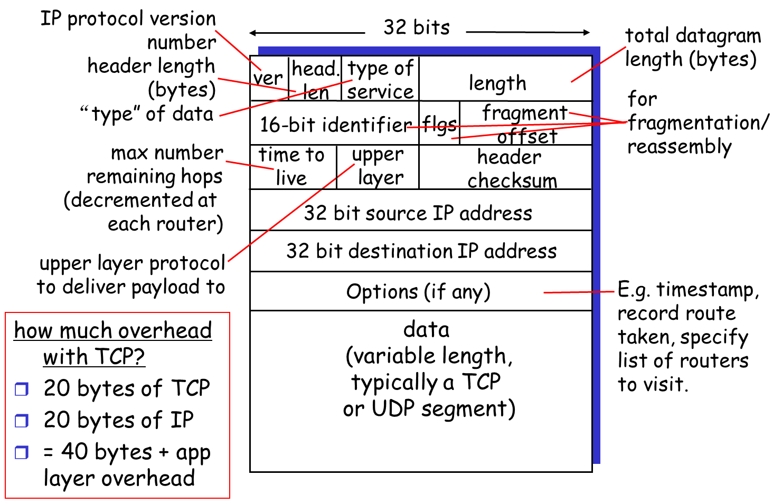
IP datagram format

Slide 3
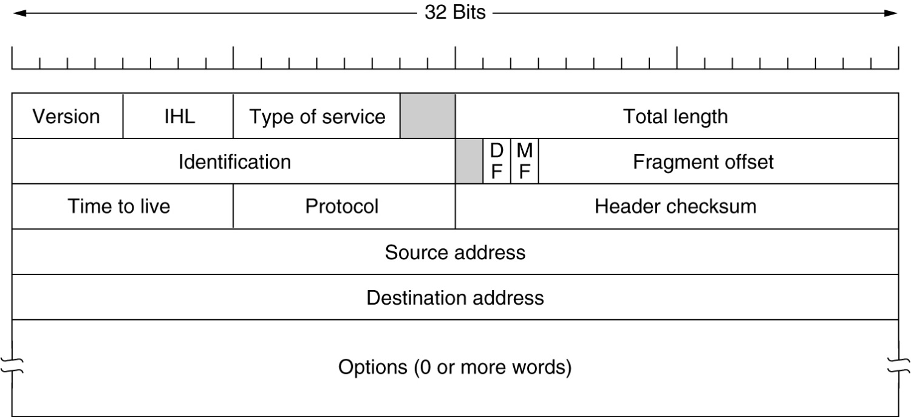
IP datagram format
20 bytes ≤ Header Length < (2⁴ – 1) x 4 bytes = 60 bytes
20 bytes ≤ Total Length < 2¹⁶ – 1 bytes = 65535 bytes

Slide 4
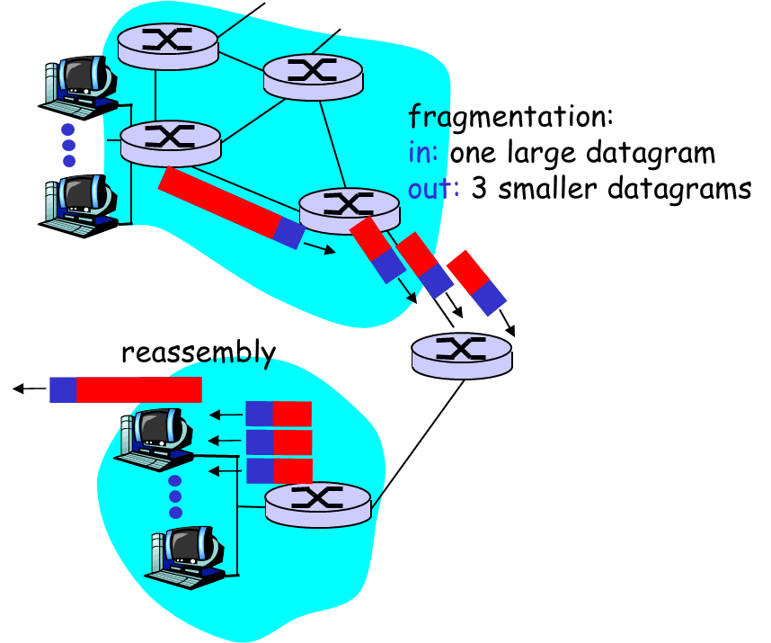
IP Fragmentation & Reassembly
network links have MTU (max. transmission size) - largest possible link-level frame.
different link types, different MTUs
large IP datagram divided (“fragmented”) within net
one datagram becomes several datagrams
“reassembled” only at final destination
IP header bits used to identify, order related fragments

Slide 5
IP Fragmentation con.
IP分组头中与分段有关的域（红色）：
Total Length: 本分段的长度。
Identification: 属于同一分组的分段有相同的Identification。
DF: 如果置1，则不允许分段。如果分组长度大于MTU, 则抛弃。
MF: 如果置1，说明还有跟在后面的分段。
Fragment Offset: 本分段中的数据相对于分段前的分组中数据的位移，单位是8个字节。

Slide 6
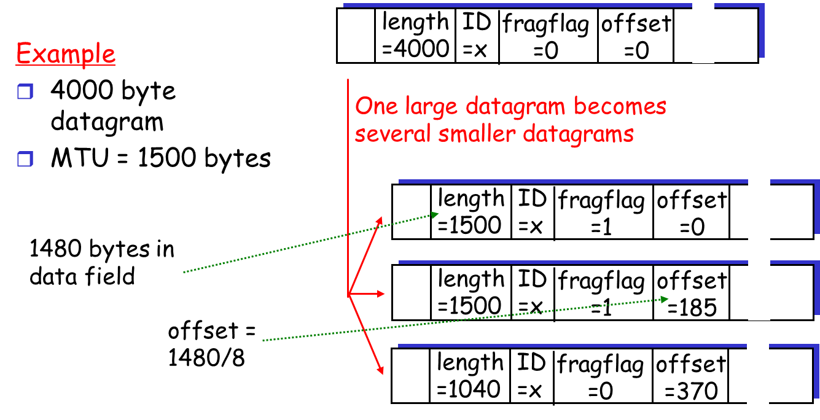
IP Fragmentation & Reassembly

Slide 7
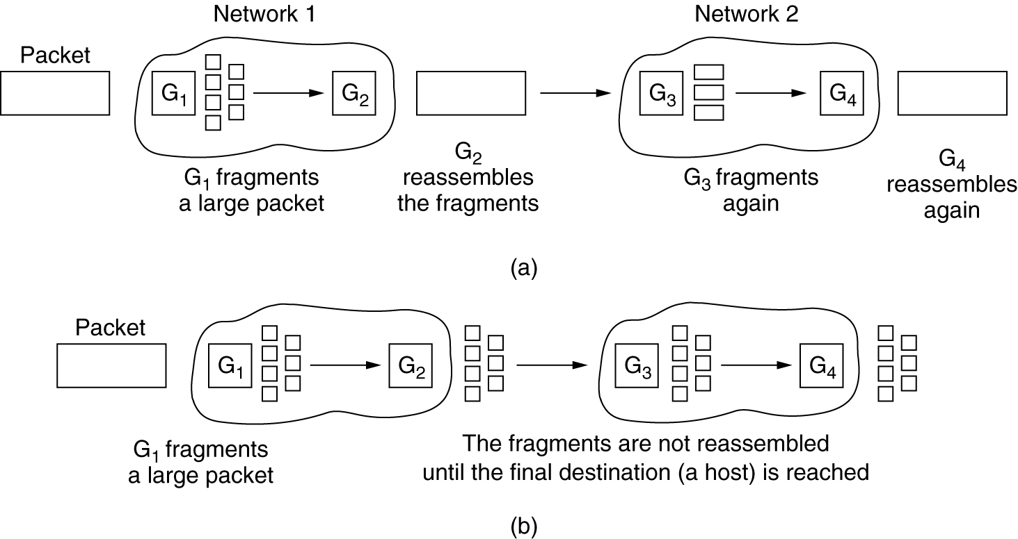
IP Fragmentation con.
Costs of fragmentation?

Slide 8

Summary
IP datagram format
IP Fragmentation & Reassembly

